Slide 1


Linear Programming Project: Optimizing Responses to Arson Calls by the Denver Metro Fire Police Department
By: SRM, EHH
Fall 2020

Slide 2
High-level Question
Can we look at fires in Denver County for the last 5 years and determine which Fire Station needs to respond to it?
Would this mean that stations should answer calls outside of their district?

Slide 3
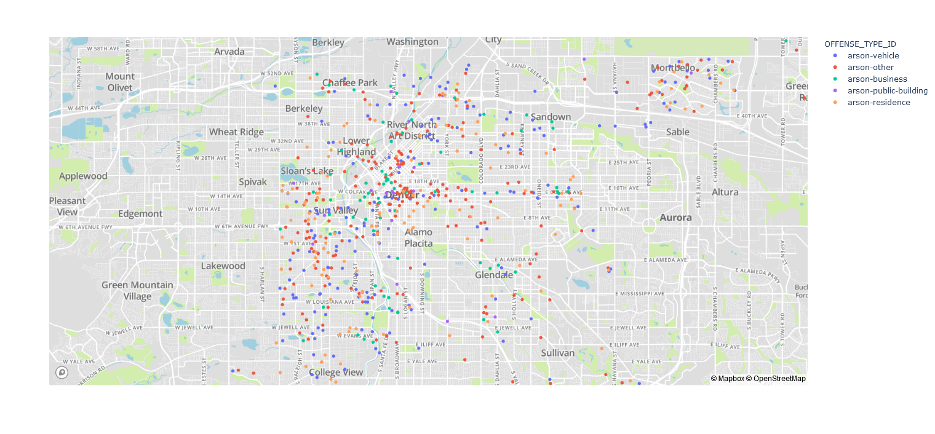
The data, continued

Slide 4
Our method
Using a mathematical optimization technique, we looked at which fire station should respond to a fire to minimize the distance between the station and the location of the fire

Slide 5
Our Findings
Per our work, we recommend in 78% of arsons that a fire station outside of the fire district be the one to respond

Slide 6
Policy Recommendations
We can see that there are an alarming number of fire stations that are responding to fires that are not within their district
We can make the valid argument that there is a need to advocate for funding to build more fire stations within the Denver-Metro Area
For future work we could take a closer look at which district is in the most need of another fire station

